Slide 1
Process Improvement Project
Jonathan Ortiz

Slide 2

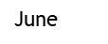
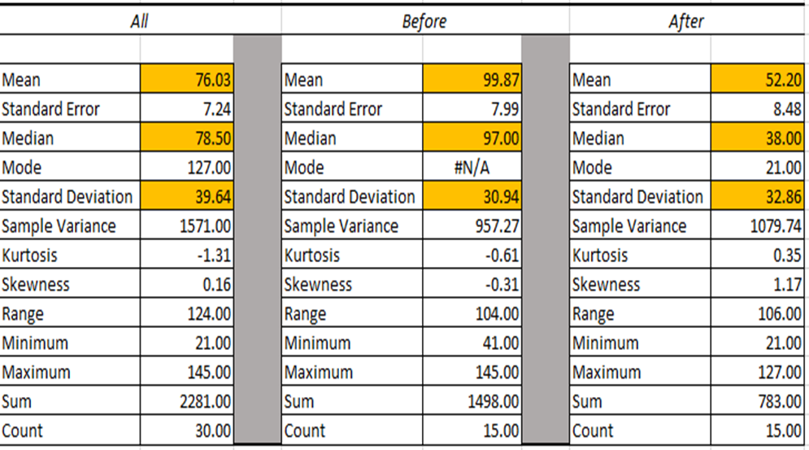
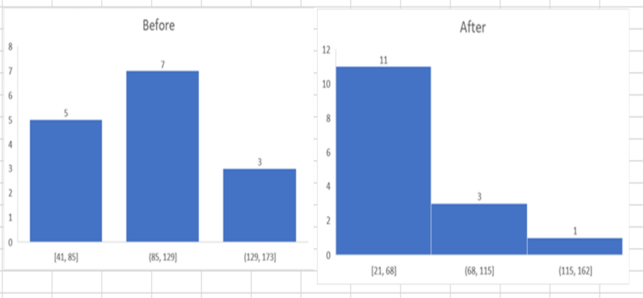
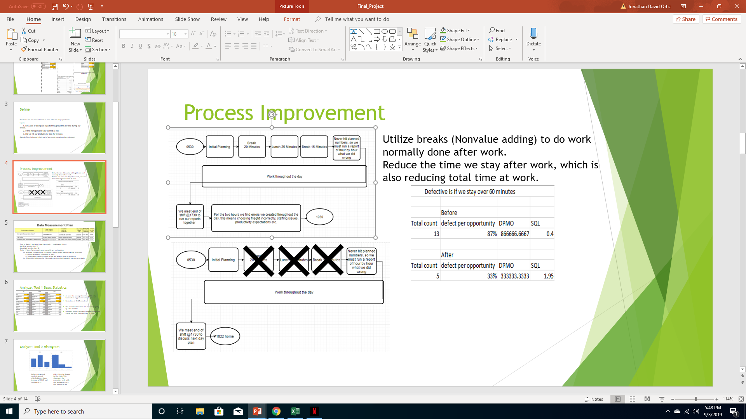
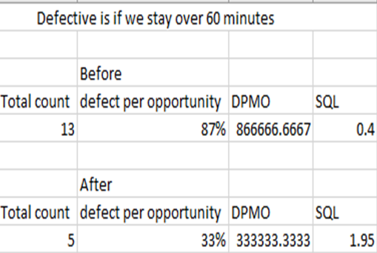
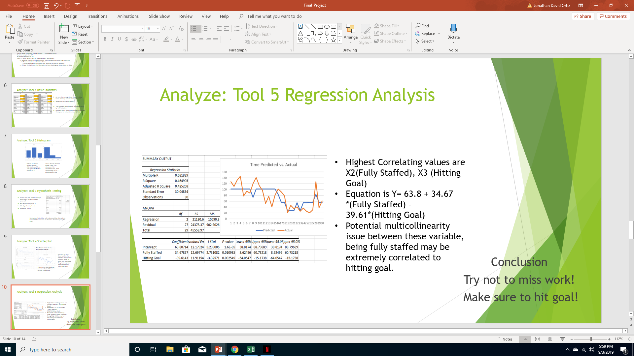
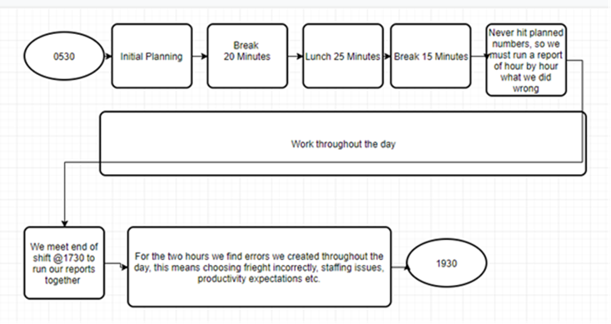
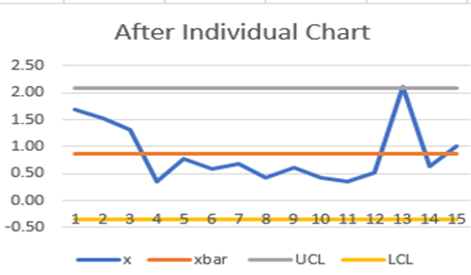
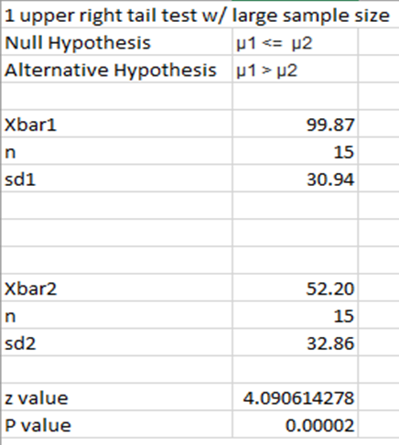
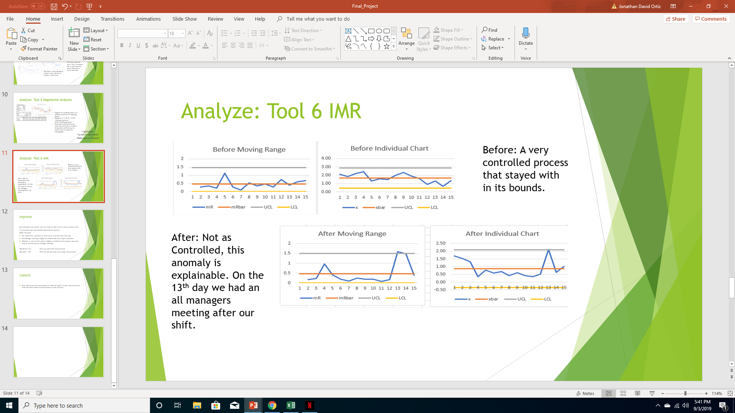
Going Home Early form Work
Jonathan Ortiz
Key Dates --->
Team
Launch
June
Define
Measure
Analyze
Aug
Improve
Aug – Sept.
Control
June-Aug
Sept onward
SQL=.4
DEFINE
MEASURE
ANALYZE
IMPROVE
A defect is staying after work for greater than 60 minutes.
Goal: decrease the time spent after operations shuts down.
SQL=1.95
Removed NVA events
CONTROL
Stay Fully staffed!
Hit Daily Productivity Goal!

Slide 3
Define
The Goal: Get out work at least an hour after we stop operations.
Inputs:
1. New plan of doing our reports throughout the day and during our breaks.
2. If the managers are fully staffed or not.
3. Did we hit our productivity goal for the day.
Output: Time between I clock out of work and operations have stopped.

Slide 4
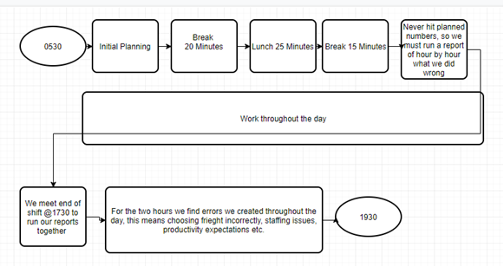
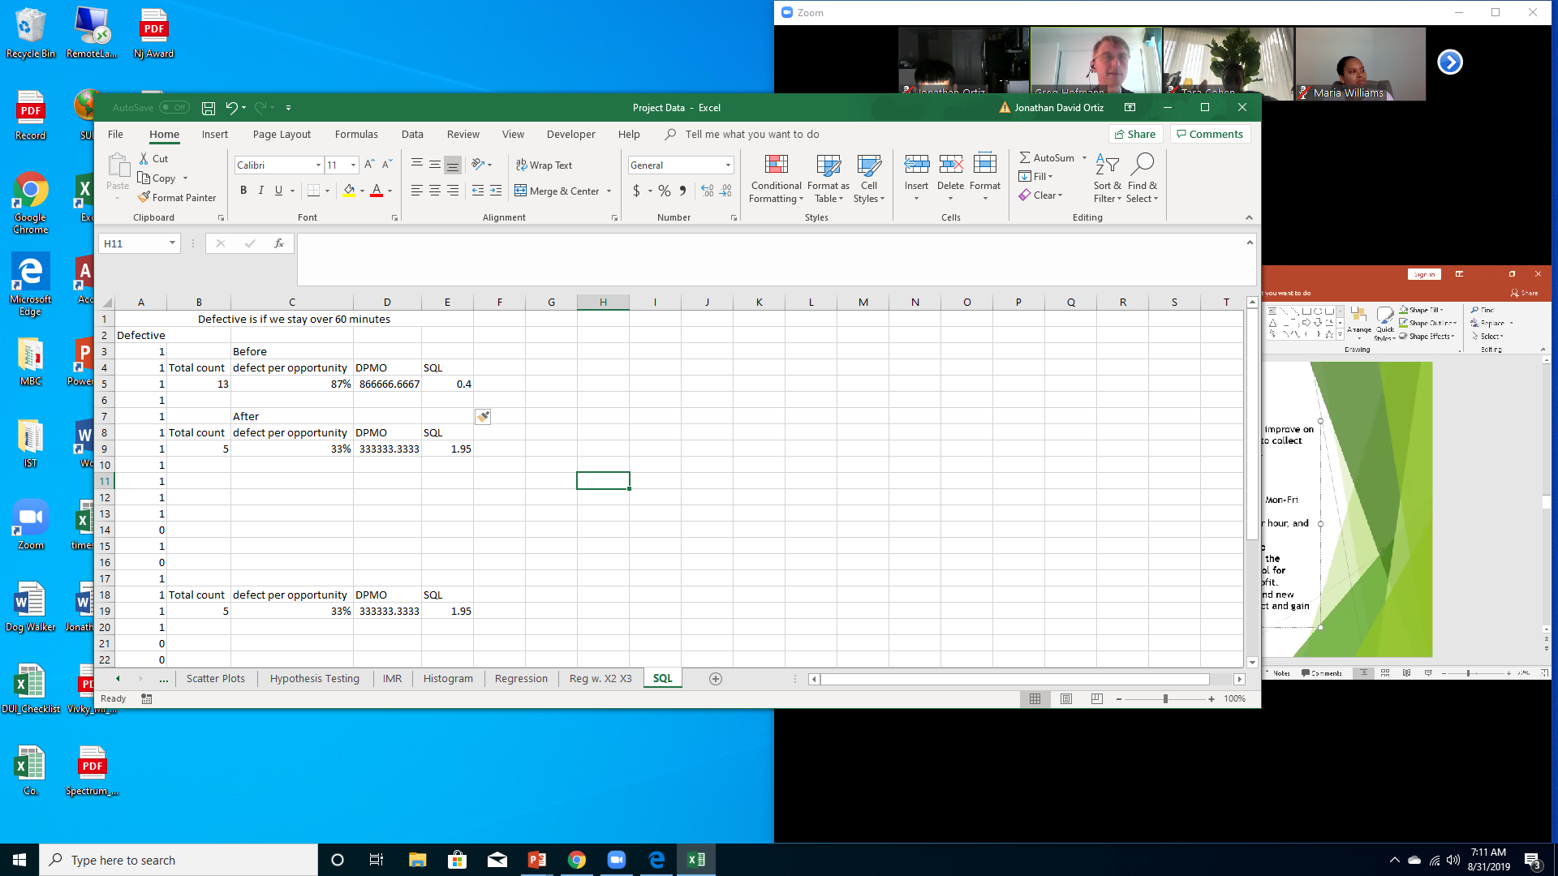
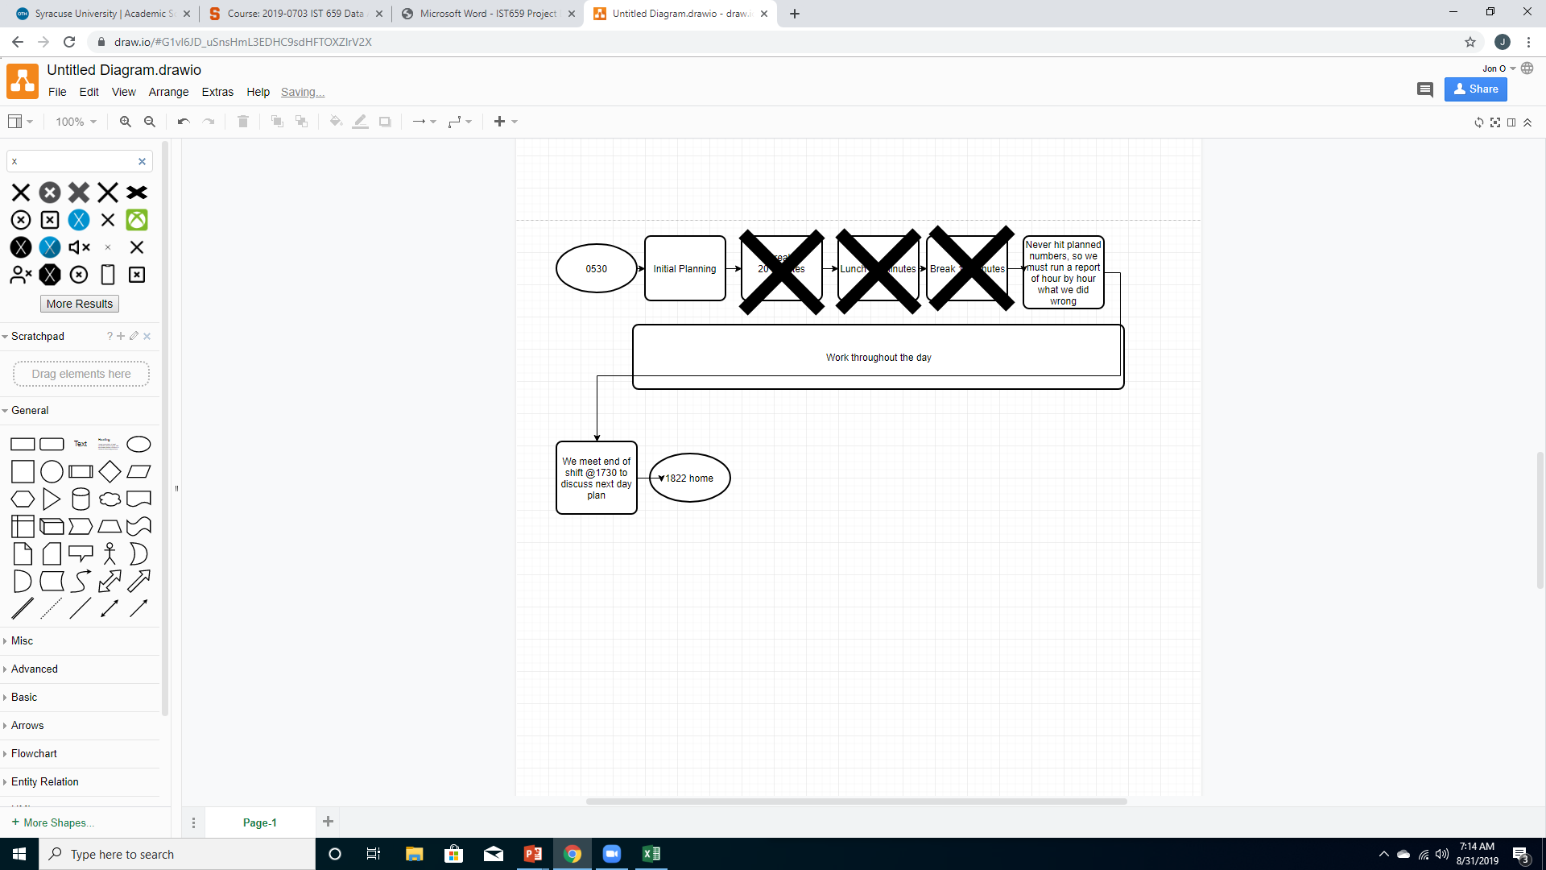
Process Improvement
Utilize breaks (Nonvalue adding) to do work normally done after work.
Reduce the time we stay after work, which is also reducing total time at work.

Slide 5
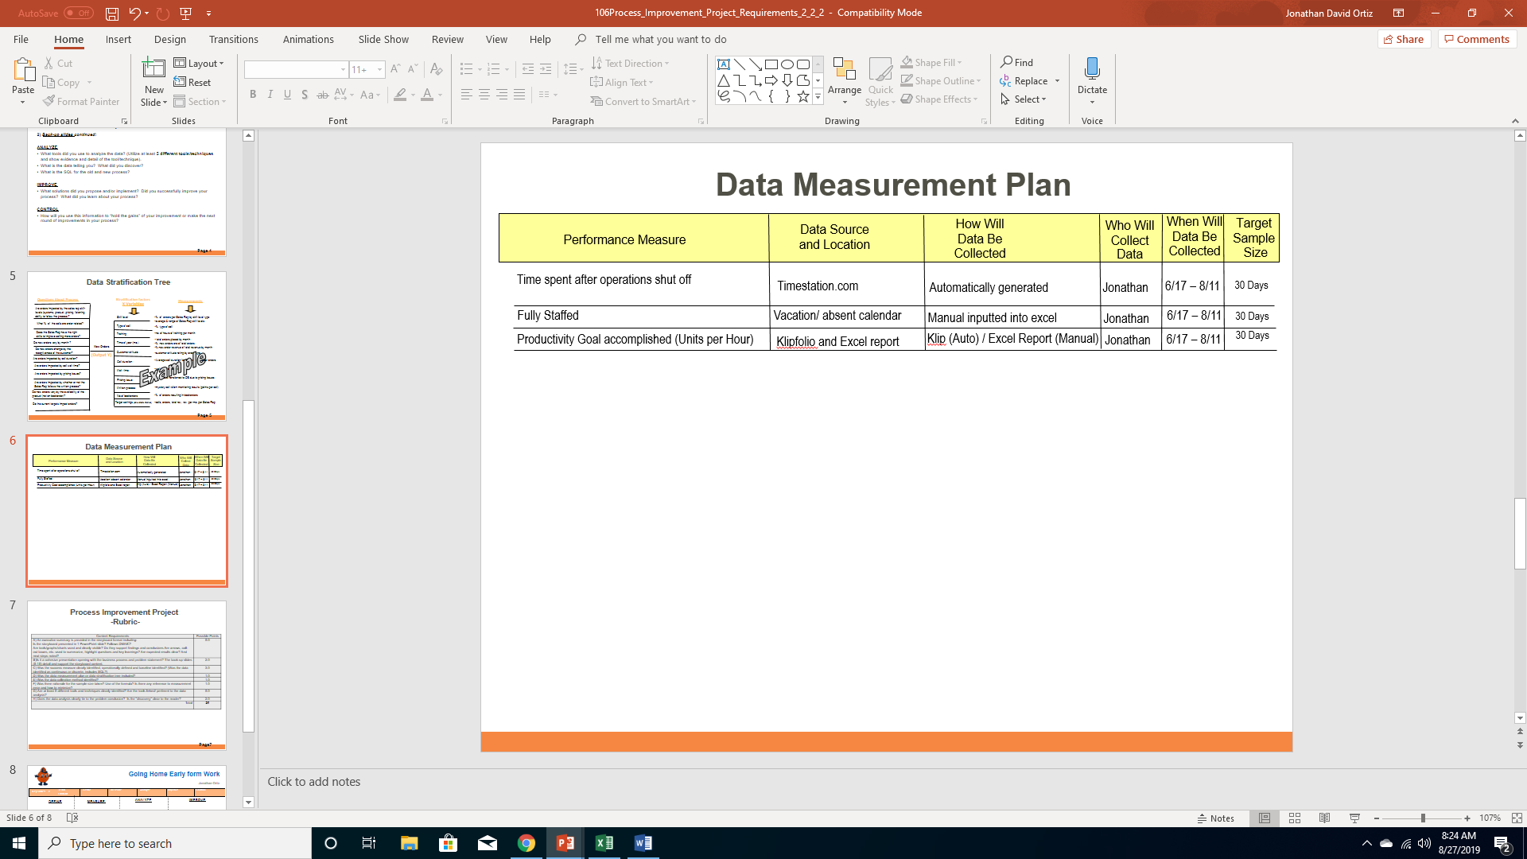
Type of Data: 2 variable binary(yes/no) , 1 continuous (time)
My ideal sample size: 57
My actual sample size: 30
Risks: 1. Some factors such as seasonality are not capture
i.e. seasonal changes bring sicknesses, which would lead to staffing problems.
2. Errors in systems collection of data
3. Time station captures clock in/out not what is done in between
i.e. If I use the bathroom for 15 minutes before clocking out it can skew my data.

Slide 6
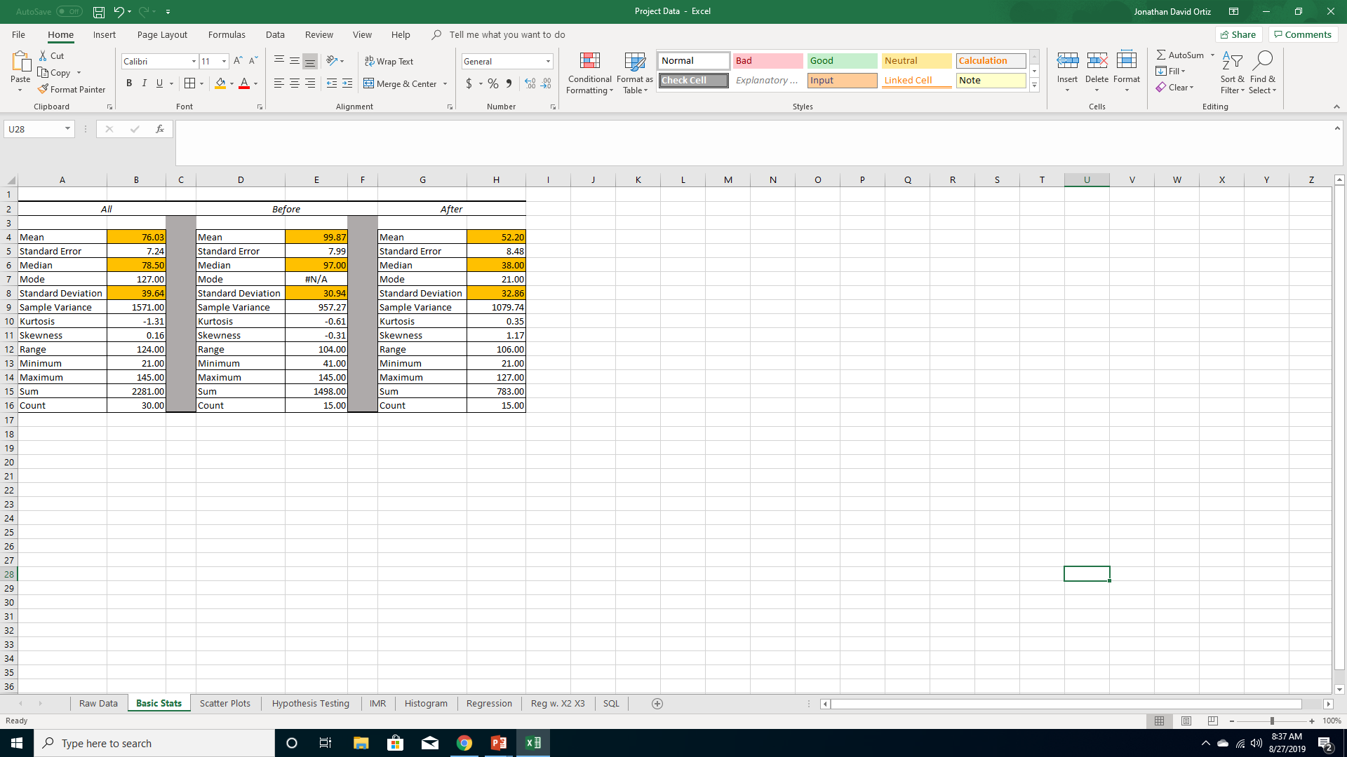
Analyze: Tool 1 Basic Statistics
As seen the average time is significantly lower after my process is implemented.
Reduction of 47.67 minutes.
The standard deviation did increase slightly by 1.92 minutes.
Although there is a drastic change in average it may not be a true decrease in time.

Slide 7
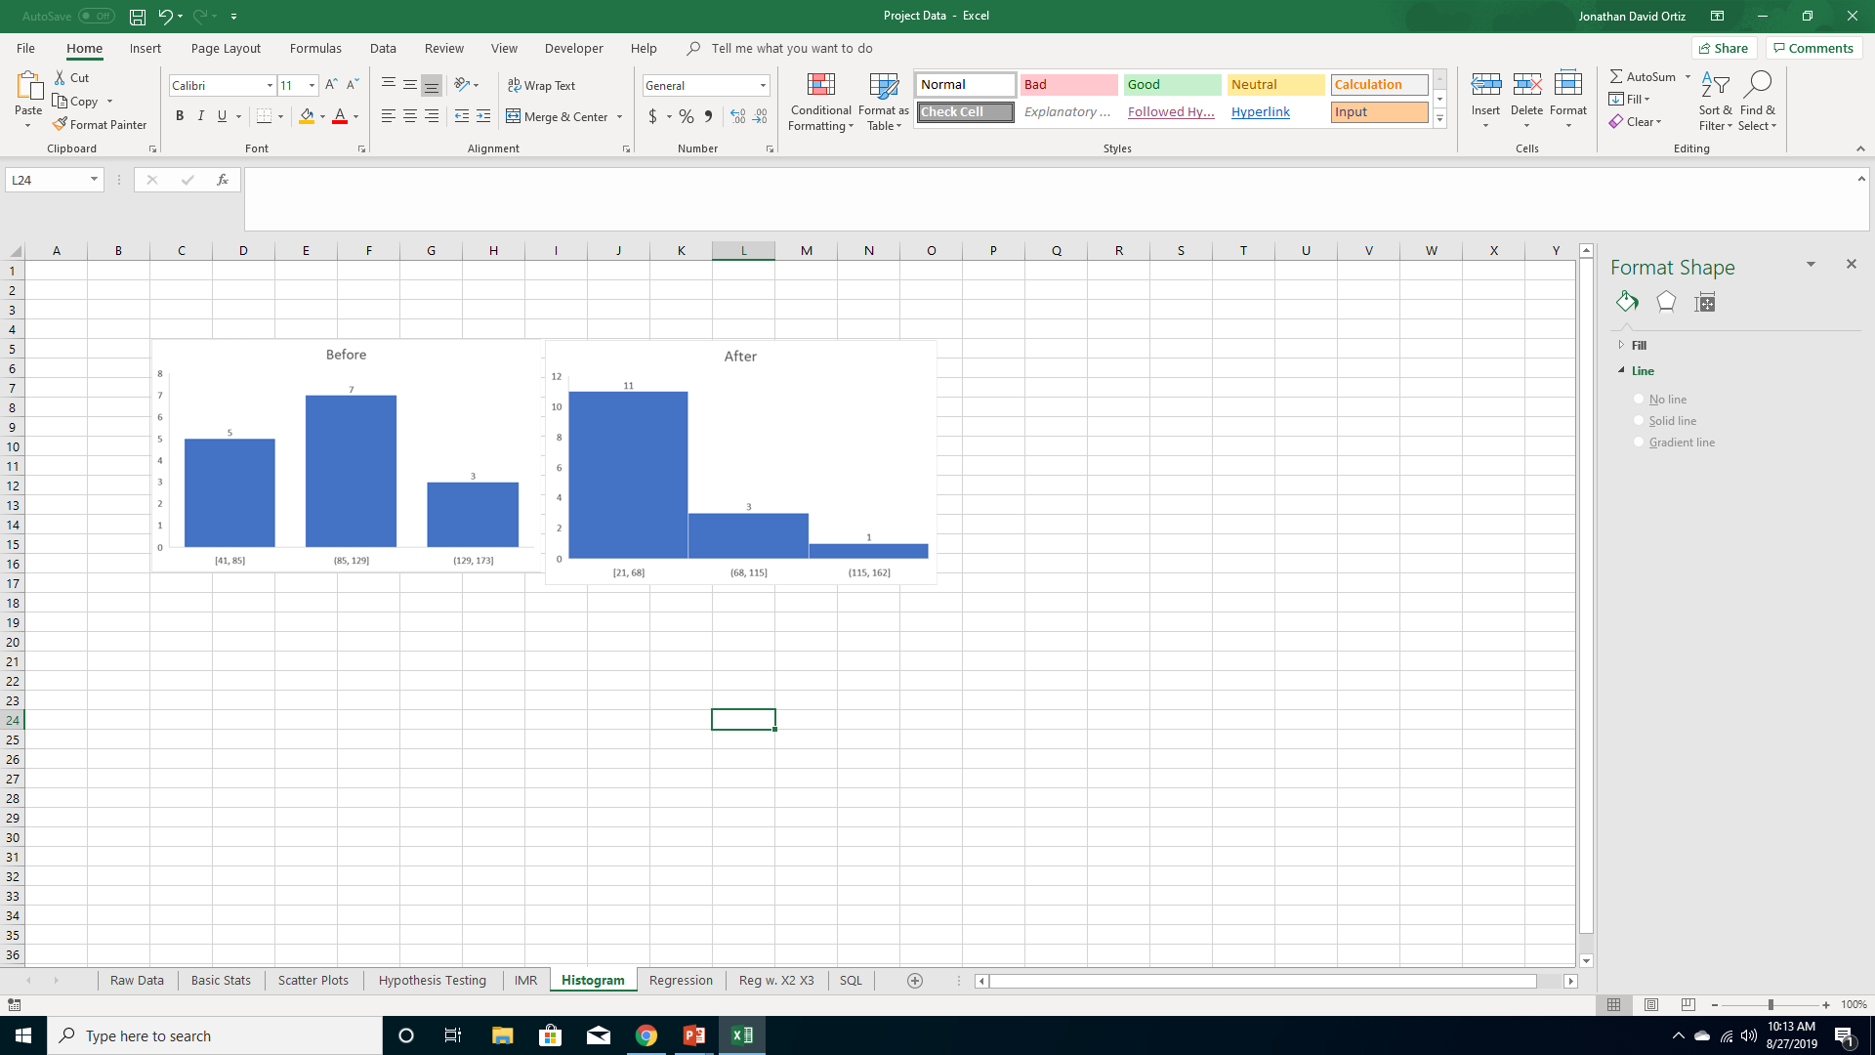
Analyze: Tool 2 Histogram
Before: An almost perfect normal distribution, with an Average of 99.87 and median of 97.
After: Heavily skewed to the right. This showcases the anomalies well, with and average of 52.2 and median of 38.

Slide 8
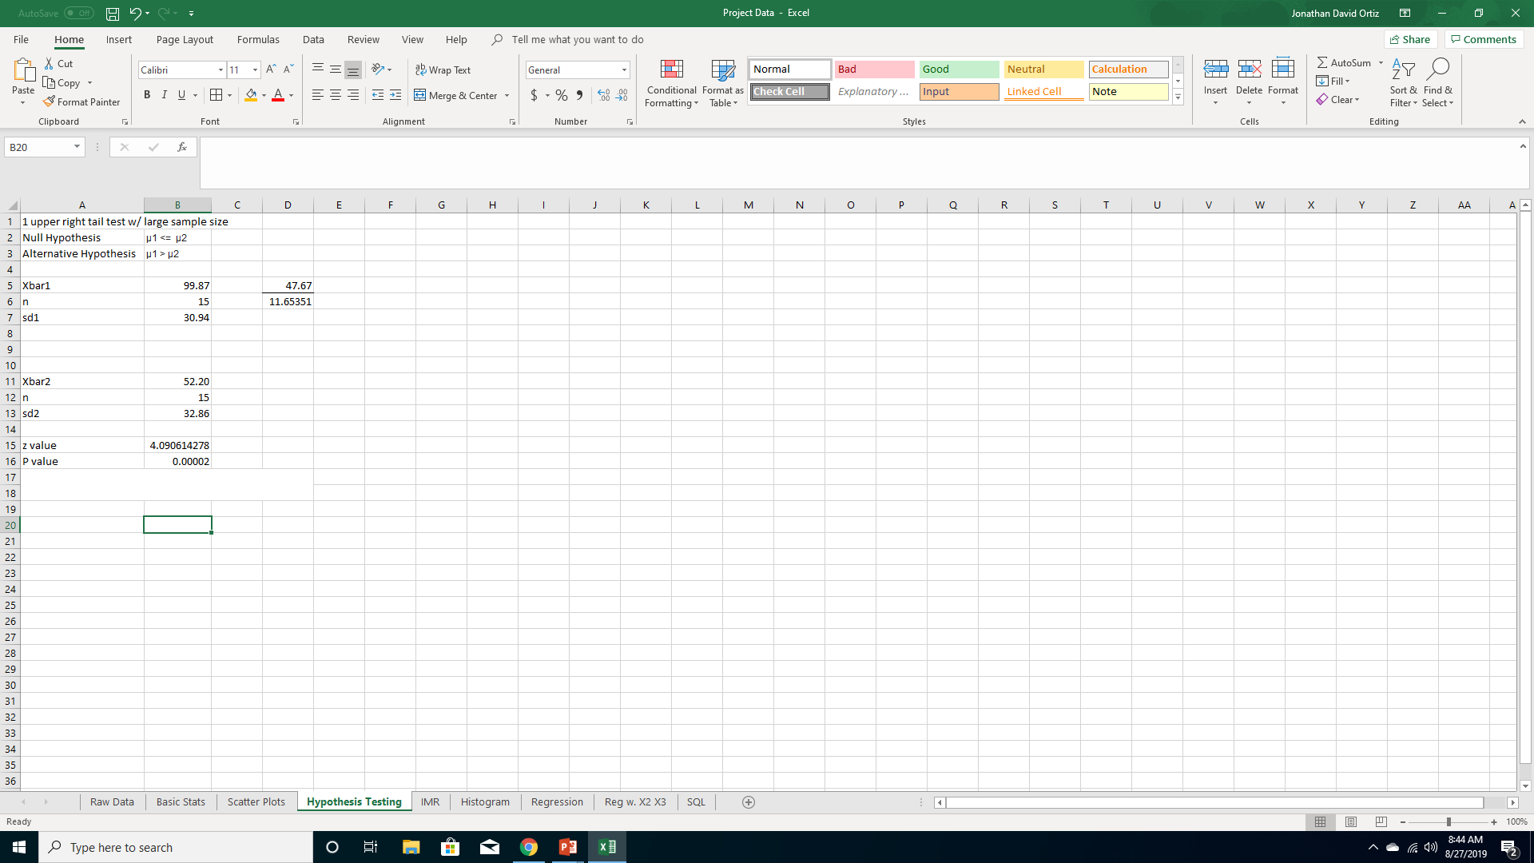
Analyze: Tool 3 Hypothesis Testing
A 1 tail test was used to verify if process 2 is in fact less than process 1
Null Hypothesis μ1 <= μ2
Alt. Hypothesis μ1 > μ2
P value is .00002
Conclusion, Reject the null and accept the Alternative.
Even with the increase of standard deviation μ1 > μ2 is true.

Slide 9
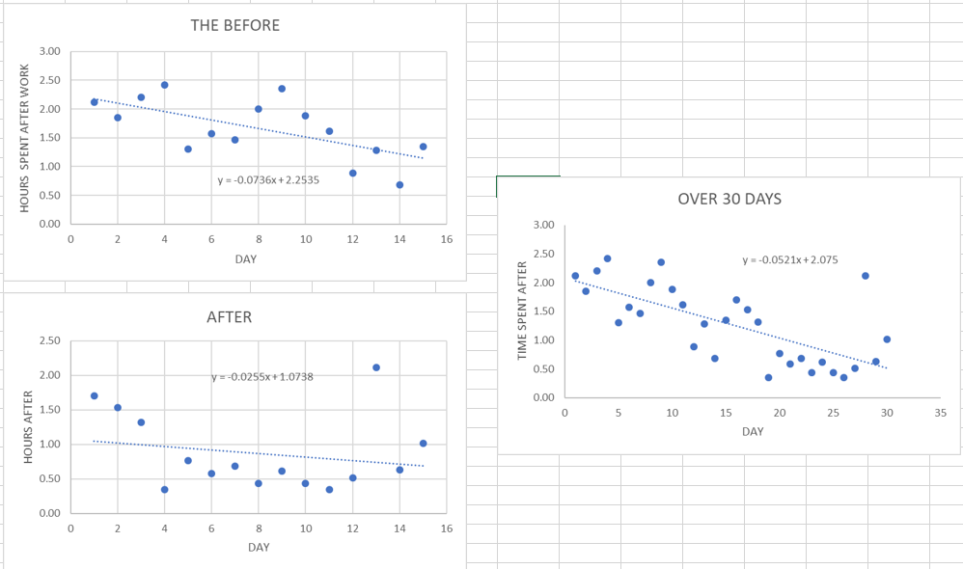
Analyze: Tool 4 Scatterplot
The Before seems to be already decreasing.
Over the 30 days there has been a dramatic decrease in the time spent at work, this is because the y intercept has been reduced by more than half.
The After is decreasing at a lower rate, but has a smaller y intercept.

Slide 10
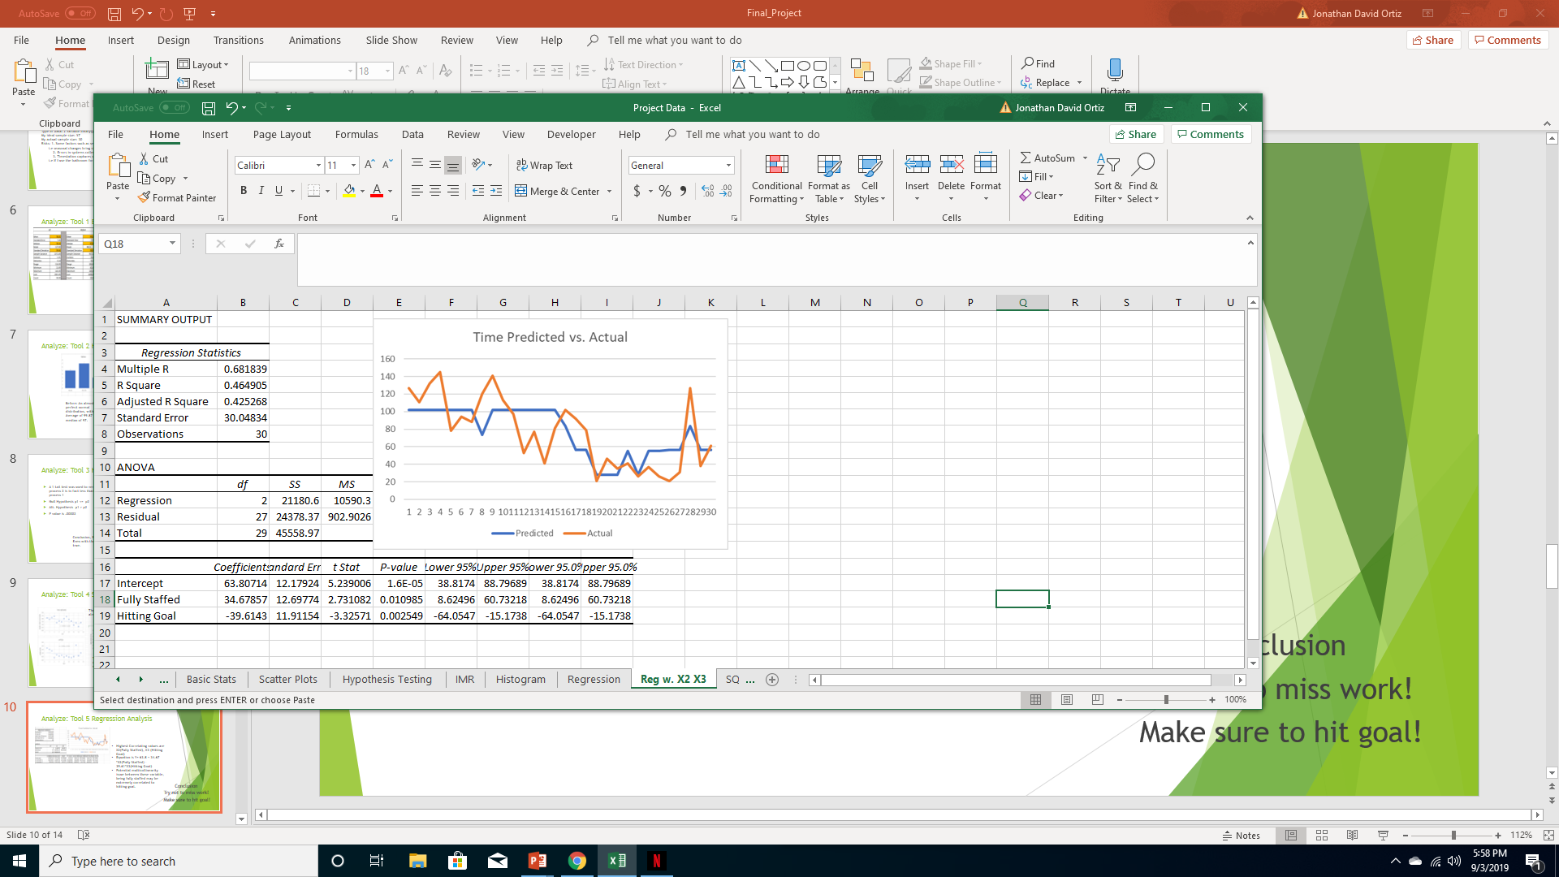
Analyze: Tool 5 Regression Analysis
Highest Correlating values are X2(Fully Staffed), X3 (Hitting Goal)
Equation is Y= 63.8 + 34.67 *(Fully Staffed) – 39.61*(Hitting Goal)
Potential multicollinearity issue between these variable, being fully staffed may be extremely correlated to hitting goal.
Conclusion
Try not to miss work!
Make sure to hit goal!

Slide 11
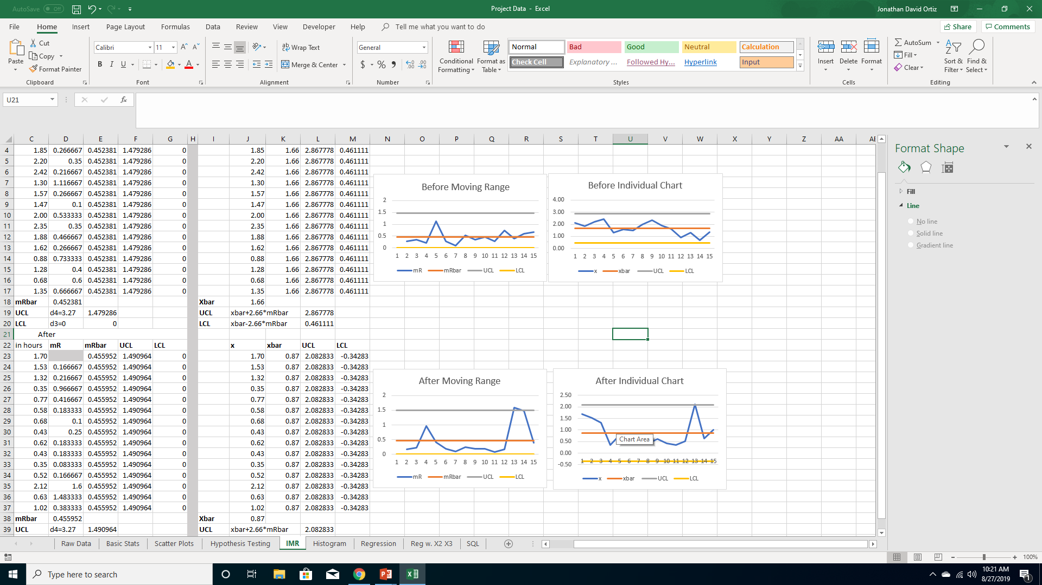
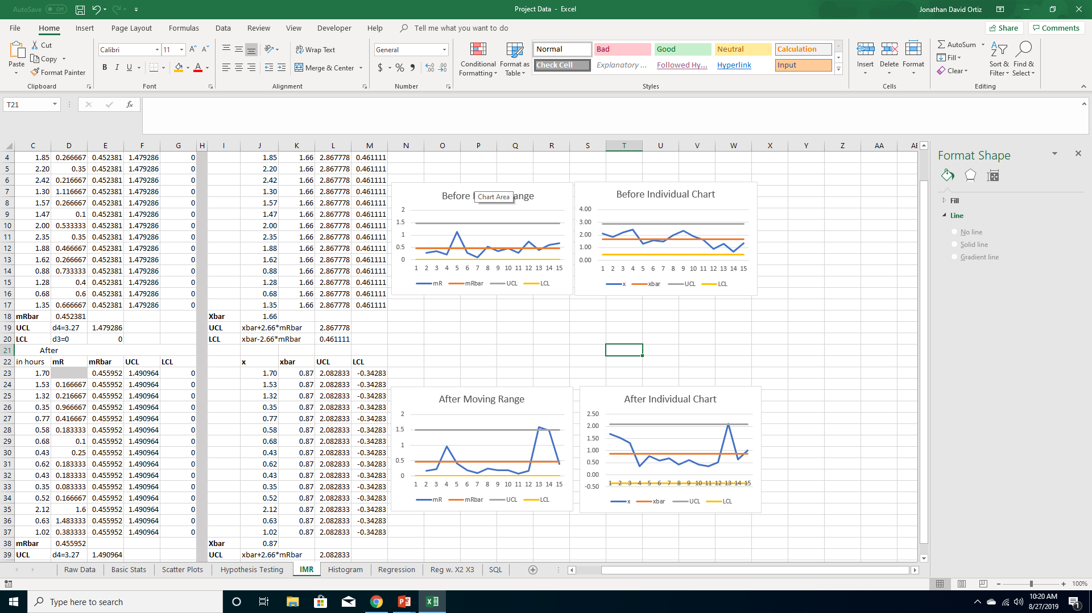
Analyze: Tool 6 IMR
Before: A very controlled process that stayed with in its bounds.
After: Not as Controlled, this anomaly is explainable. On the 13th day we had an all managers meeting after our shift.

Slide 12
Improve
My proposition was simple, use our breaks to take care of work we have to do.
I am proud to say I successfully improved my process.
What I learned:
We waste time, and have to make up for it at the end of the day.
Full Manager staffing is highly correlated with how long we stay late.
Whether or not we hit or goal is highly correlated to how long we stay and may be effected by our manager staffing.
SQL Before: 0.4 Very Low and needs improvement.
SQL After: 1.95 Still Low and not ideal, but a huge improvement.

Slide 13
Control
The most important things to do now is to make sure we hit our productivity goals.
My next step will be to find out what is to start our process improvement project, but this time on our operations.
There should be direct correlation between operations improvement and going home on-time/early.

